Slide 1

DATA SCIENCE
STATISTICS FOR DATA SCIENCE
Narla Sandeep 4968-Bangalore
EXL Services Certified Associate in Data Analytics

Slide 2

Introduction to statistics
Descriptive statistics
Dispersion
Shape
Inferential Statistics
Central Limit Theorem
EMPIRICAL RULE
Zscores
Skewness

Slide 3
Introduction
Statistics: Statistics as a science dealing with the collection, analysis, interpretation, and presentation of numerical data.
Population: Population as a collection of persons, objects, or items of interest.
Sample: Sample is a portion of the whole and, if properly taken, is representative of the whole

Slide 4
TYPE OF STATISTICSof Statistics
1.DISCRIPTIVE STATSTISTICS
2.INFERENTIAL STATISTICS
we will discuss about the both now.
Descriptive statistics is used to describe the all data. It is again devided in to three main types. They are :
Measure of Central Tendency
Dispersion
Shape
Inferential Statistics is used describe entire population using a sample of the data .
Here we have two main terminologies . They are:
Population
Sample
1/7
EXL Services Certified Associate in Data Analytics

Slide 5
Descriptive Statistics
1. Measures of Central Tendency(Togetherness of data)
It is a number which describes all the data in single number.
Its talks about together ness of data.
Now we will see three different types in the Measure of Central Tendency
MEAN
Mean is nothing but ‘Average’.
One number which represent entire attribute / column.
Mean is Influenced by “Outliers”.
MEDIAN
It is a middle value of the sorted data .
Median is not influenced by “Outliers”
MODE
Mode is most recurring element of the column
EXL Services Certified Associate in Data Analytics
2/7

Slide 6
Dispersion
Dispersion or Statistical variability both are same, it talks about spread of the data . Measure of Statistical variability or dispersion shows how far or what is the distance between each data point from central tendency or average.
It is divided into three types
VARIANCE
Variance talks about how much data point are spread around the mean. Average squared distance from the mean.
STANDARD DEVIATION
Square root of variance is called the Standard Deviation.
QUARTILES
Quartile is a measure that will divide entire data into four equal parts.
3/7
EXL Services Certified Associate in Data Analytics

Slide 7
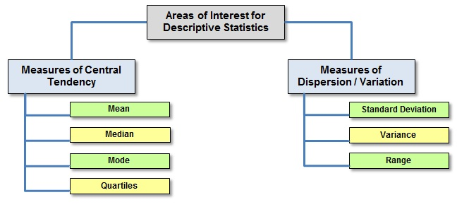

Slide 8
Shape
It deals with Shape of distribution. There are two types to measure for shape of the distribution they are
Skewness : It is measure of symmetry of the probability distribution. This is of three types
Positive Skewness : The tail of the distribution is towards right side
Negative Skewness : The tail of the distribution is towards left side
Normal Distributed (No skew)
Kurtosis : Measure of ‘Peakedness’ of the distribution.
Lepto Kurtic: This is when peak is above the normal distribution. Kurtosis = 1
Meso Kurtic: Here is distribution is looks like normally distribution. Kurtosis = 0
Platy Kurtic: Here the peak of the distribution is less than normally distribution.
i.e kurtosis = -1
EXL Services Certified Associate in Data Analytics
4/7

Slide 9
Inferential Statistics
Inferential Statistics allow you to make inferences about the population from the sample of the data .
Population: Population is a universe on which study is don. In other words this is the entire data on which we are doing model building.
Sample : A Sample is a representative subset of the population.
Sampling Distribution: Sample mean become more and more normally distributed
around the true mean ( population mean)as we increase sample size ,the variability of sample mean will decrease as sample size increase.
5/7
EXL Services Certified Associate in Data Analytics

Slide 10
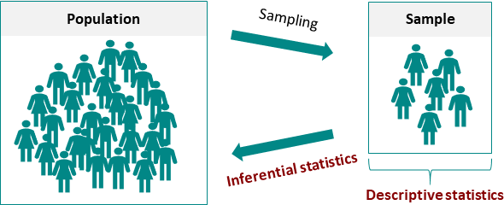

Slide 11
Central Limit Theorem
The Mean of Sample means is the same as population mean.
Standard Deviation of sample mean is always equals to the standard error
The distribution of sample mean will become increasingly more normal as the sample size increases.
Confidence Interval:
As sample mean can referred to as a point estimate of population mean .
A confidence interval is always centered around the mean of your sample.
To Construct the interval, you add a marginal error. The margin of error is found by multiplying the SE of the mean by Z-Score of the present confidence level
6/7
EXL Services Certified Associate in Data Analytics

Slide 12
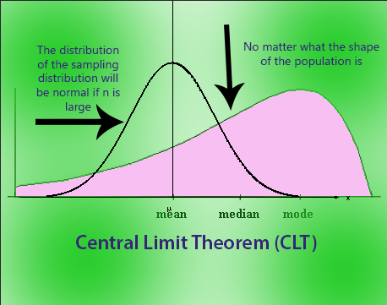

Slide 13
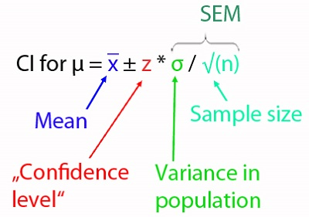
Confidence Interval
EXL Services Certified Associate in Data Analytics
7/7

Slide 14
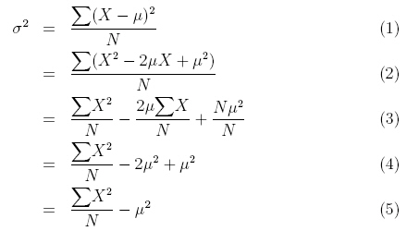
Variance: -The variance is the average of the squared deviations about the arithmetic mean for a set of numbers. The population variance is denoted by σ^2.

Slide 15
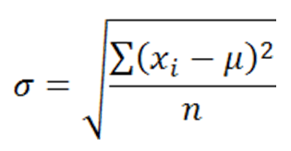
Standard Deviation:- The standard deviation is the positive square root of the variance. The population standard deviation is denoted by σ.

Slide 16
EmpEMPIRICAL RULEiricul
The empirical rule is an important rule of thumb that is used to state the approximate percentage of values that lie within a given number of standard deviations from the mean of a set of data if the data are normally distributed.
Distance from the Mean | Values Within Distance
μ+σ to μ-σ | 68%
μ+2σ to μ-2σ | 95%
μ+3σ to μ-3σ | 99.7%

Slide 17
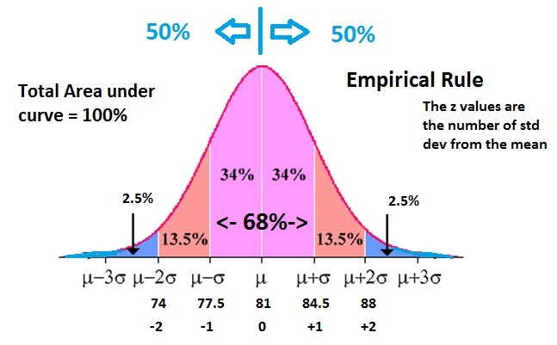
Empirical Rule

Slide 18
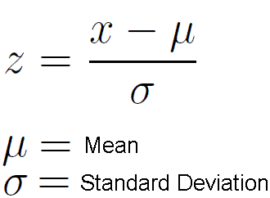
z Scores
A z score represents the number of standard deviations a value (x) is above or below the mean of a set of numbers when the data are normally distributed. Using z scores allows translation of a value’s raw distance from the mean into units of standard deviations.

Slide 19
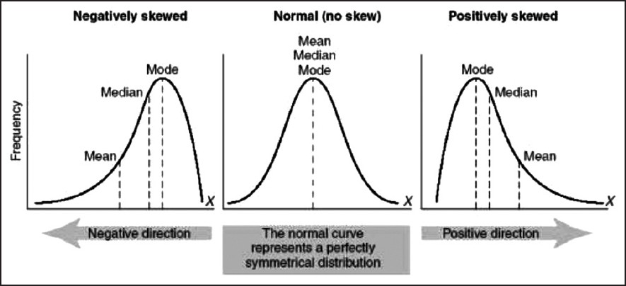
Skewness
A distribution of data in which the right half is a mirror image of the left half is said to be symmetrical.
Skewness is when a distribution is asymmetrical or lacks symmetry.

Slide 20
Thank you!
EXL Services Certified Associate in Data Analytics

